Slide 1
SCM project file by- Bhavik chopra 2110990359

Slide 2

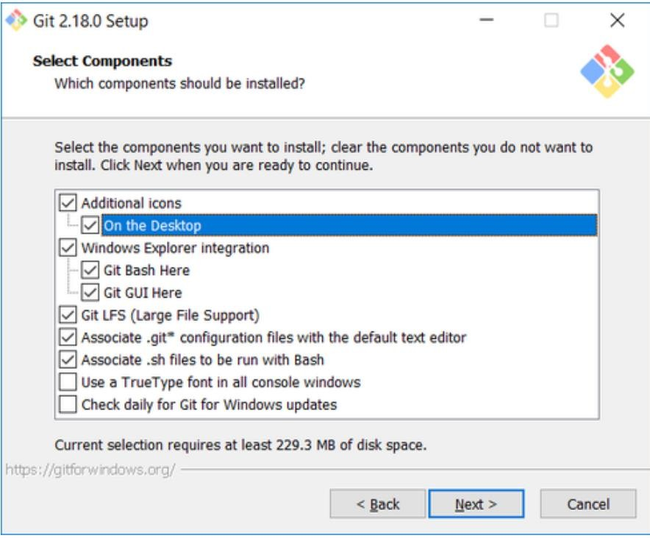
Experiment No. 01
Aim: Setting up the git client.
Git Installation: Download the Git installation program (Windows, Mac, or Linux) from Git - Downloads (git-scm.com).
When running the installer, various screens appear (Windows screens shown). Generally, you can accept the default selections, except in the screens below where you do not want the default selections:
In the Select Components screen, make sure Windows Explorer Integration is selected as shown:
In the choosing the default editor is used by Git dialog, it is strongly recommended that you DO NOT select default VIM editor- it is challenging to learn how to use it, and there are better

Slide 3
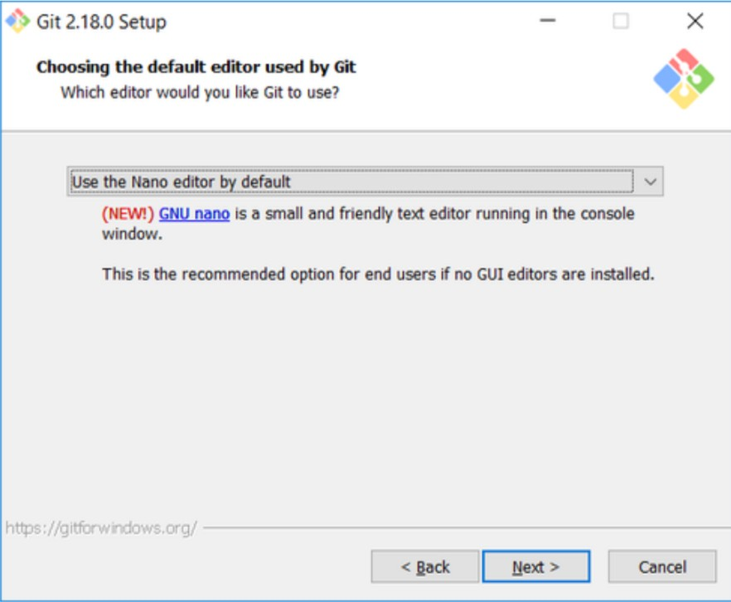
modern editors available. Instead, choose Notepad++ or Nano – either of those is much easier to use. It is strongly recommended that you select Notepad++.
In the Adjusting your PATH screen, all three options are acceptable:
Use Git from Git Bash only: no integration, and no extra command in your command path.
Use Git from the windows Command Prompt: add flexibility – you can simply run git from a windows command prompt, and is often the setting for people in industry – but this does add some extra commands.
Use Git and optional Unix tools from the Windows Command Prompt: this is also a robust choice and useful if you like to use Unix like commands like grep.

Slide 4
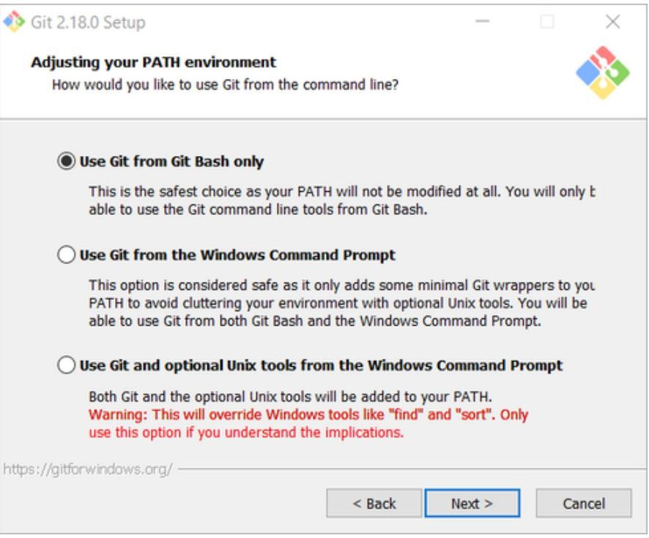
In the Configuring the line ending screen, select the middle option (Checkout-as-is, commit Unix-style line endings) as shown. This helps migrate files towards the Unix-style (LF) terminators that most modern IDE’s and editors support. The Windows convention (CR-LF line termination) is only important for Notepad.

Slide 5
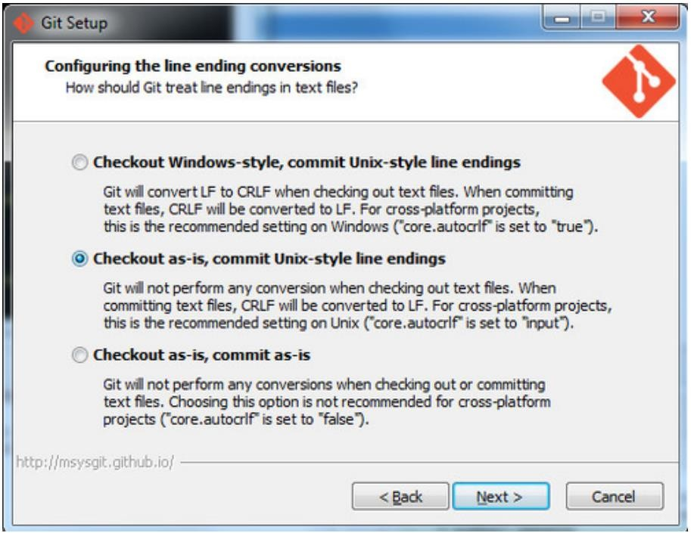
Configuring Git to ignore certain files:
This part is extra important and required so that your repository does not get cluttered with garbage files.
By default, Git tracks all files in a project. Typically, this is not what you want; rather, you want Git to ignore certain files such as .bak files created by an editor or .class files created by the Java compiler. To have Git automatically ignore particular files, create a file named .gitignore ( note that the filename begins with a dot) in the C:\users\name folder (where name is your MSOE login name).
NOTE: The .gitignore file must NOT have any file extension (e.g. .txt). Windows normally tries to place a file extension (.txt) on a file you create from File Explorer - and then it (by default) HIDES the file extension. To avoid this, create the file from within a useful editor (e.g. Notepad++ or UltraEdit) and save the file without a file extension).

Slide 6
Edit this file and add the lines below (just copy/paste them from this screen); these are patterns for files to be ignored (taken from examples provided at https://github.com/github/gitignore.)
#Lines (like this one) that begin with # are comments; all other lines are rules
# common build products to be ignored at MSOE
*.o
*.obj
*.class
*.exe
# common IDE-generated files and folders to ignore workspace.xml
bin
/ out
/
.classpath
# uncomment following for courses in which Eclipse .project files are not checked in # .project
#ignore automatically generated files created by some common applications, operating systems
*.bak
*.log
*.ldb
~*
.DS_Store*
._* Thumbs.d b
# Any files you do not want to ignore must be specified starting with ! # For example, if you didn't want to ignore .classpath, you'd uncomment the following rule: #
!.classpath
Note: You can always edit this file and add additional patterns for other types of files you might want to ignore. Note that you can also have a
.gitignore files in any folder naming additional files to ignore. This is useful for project- specific build products.
Once Git is installed, there is some remaining custom configuration you must do. Follow the steps below:

Slide 7
From within File Explorer, right-click on any folder. A context menu appears containing the commands " Git Bash here" and "Git GUI here". These commands permit you to launch either Git client. For now, select Git Bash here.
Enter the command (replacing name as appropriate) git config -- global core.excludesfile c:/users/name/. gitignore
This tells Git to use the .gitignore file you created in step 2
NOTE: TO avoid typing errors, copy and paste the commands shown here into the Git Bash window, using the arrow keys to edit the red text to match your information.
Enter the command git config --global user.Email "name@msoe.edu"
This links your Git activity to your email address. Without this, your commits will often show up as "unknown login". Replace name with your own MSOE email name.
d Enter the command git config --global user.name "Your Name"
Git uses this to log your activity. Replace "Your Name" by your actual first and last name.
e. Enter the command git config --global push.default simple
This ensures that all pushes go back to the branch from which they were pulled. Otherwise pushes will go to the master branch, forcing a merge.

Slide 8
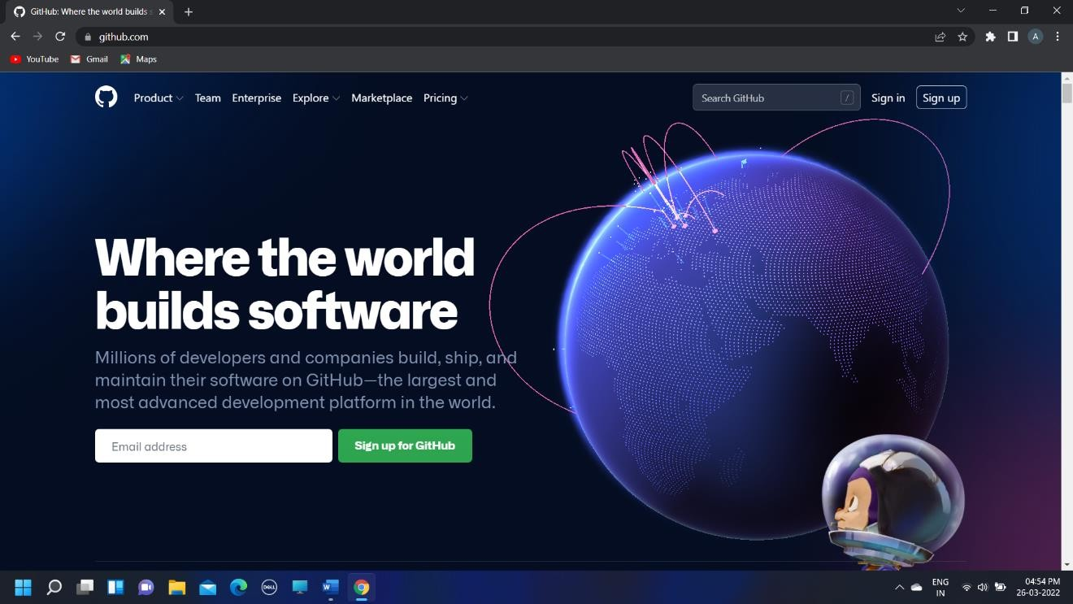
Experiment No. 02
Aim
Setting up GitHub Account
The first steps in starting with GitHub are to create an account, choose a product that fits your needs best, verify your email, set up two-factor authentication, and view your profile.
There are several types of accounts on GitHub. Every person who uses GitHub has their own user account, which can be part of multiple organisations and teams. Your user account is your identity on GitHub.com and represents you as an individual.
1. Creating an account: To sign up for an account on GitHub.com, navigate to
https://github.com/ and follow the prompts.
To keep your GitHub account secure you should use a strong and unique password.
For more information, see “Creating a strong password”.
2. Choosing your GitHub product: You can choose GitHub Free or GitHub Pro to get access to different features for your personal account. You can upgrade at any time if you are unsure at first which product you want.
For more information on all GitHub’s plans, see “GitHub's products”.

Slide 9
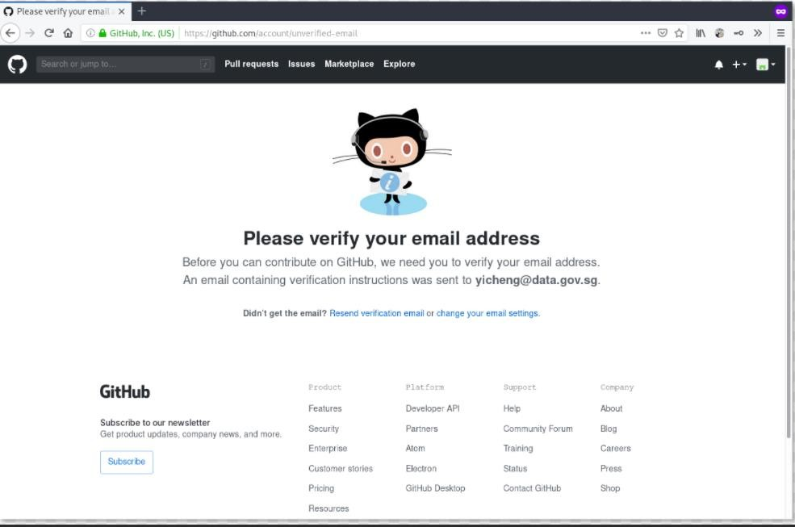
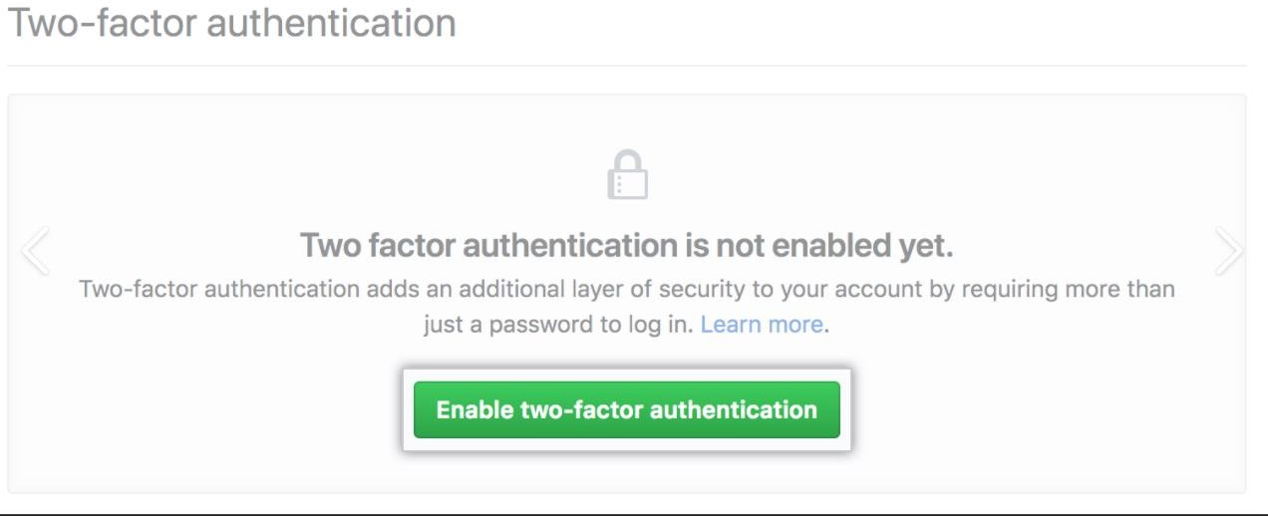
3. Verifying your email address: To ensure you can use all the features in your GitHub plan, verify your email address after signing up for a new account. For more information, see “Verifying your email address”.
4. Configuring two-factor authentication: Two-factor authentication, or 2FA, is an extra layer of security used when logging into websites or apps. We strongly urge you to configure 2FA for safety of your account. For more information, see “About two-
factor authentication."

Slide 10
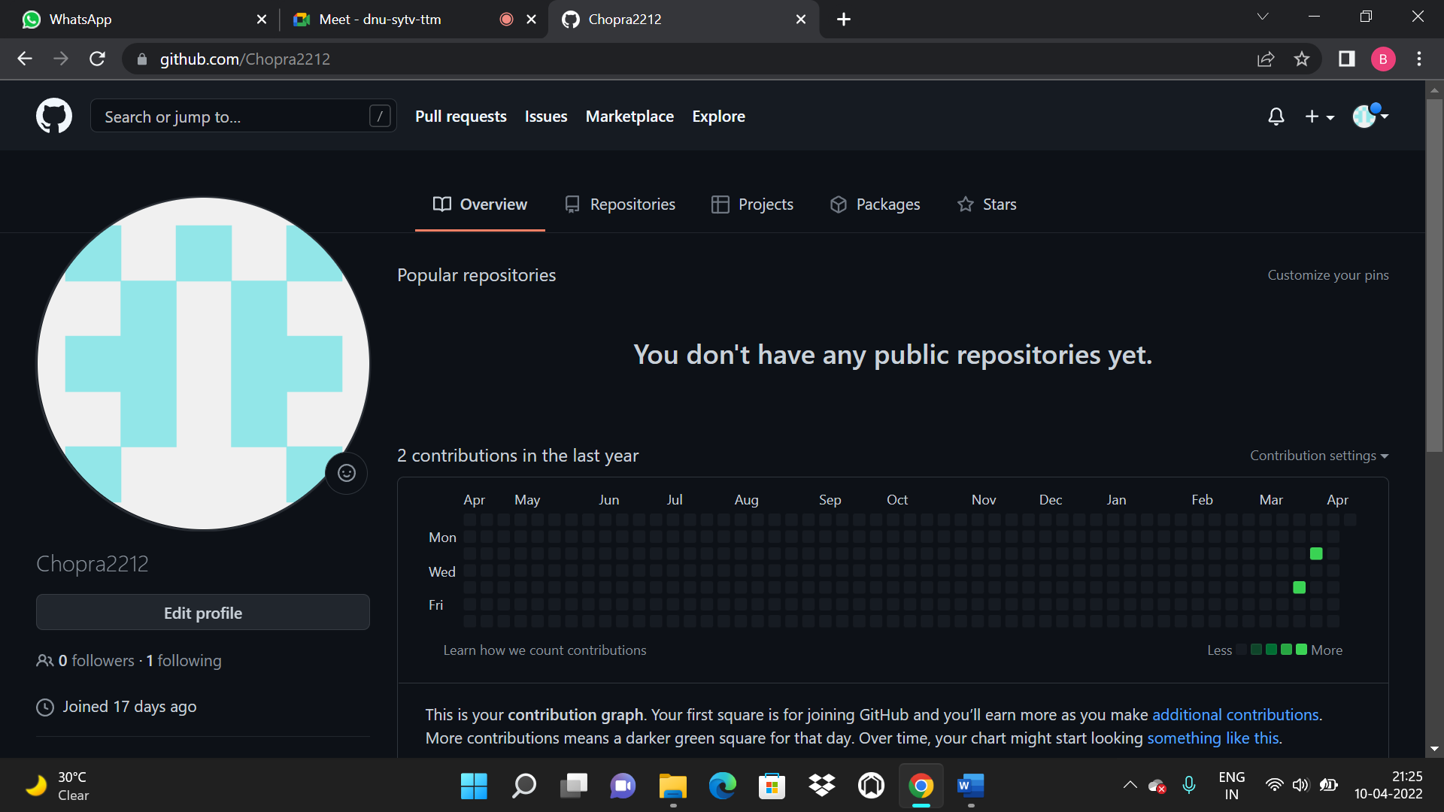
5. Viewing your GitHub profile and contribution graph: Your GitHub profile tells people the story of your work through the repositories and gists you’ve pinned, the organisation memberships you’ve chosen to publicize, the contributions you’ve made, and the projects you’ve created. For more information, see “About your profile” and “Viewing contributions on your profile.”

Slide 11
Experiment No. 03
Aim: Program to generate logs
Basic Git init
Git init command creates a new Git repository. It can be used to convert an existing, undersigned project to a Git repository or initialize a new, empty repository. Most other Git commands are not available outside of an initialize repository, so this is usually the first command you’ll run in a new project.
Basic Git status
The git status command displays the state of the working directory and the staging area. It lets you see which changes have been staged, which haven't, and which files aren't being tracked by Git. Status output does not show you any information regarding the committed project history.
Basic Git commit
The git commit command captures a snapshot of the project's currently staged changes.
Committed snapshots can be thought of as “safe” versions of a project—Git will never change
them unless you explicitly ask it to. Prior to the execution of git commit, The | git add | command
is used to promote or 'stage' changes to the project that will be stored in a commit. These
two commands git commit and git add are two of the most frequently used
Basic Git add command
The git add command adds a change in the working directory to the staging area. It tells Git that you want to include updates to a particular file in the next commit. However, git add doesn't really affect the repository in any significant way—changes are not actually recorded until you run git commit

Slide 12
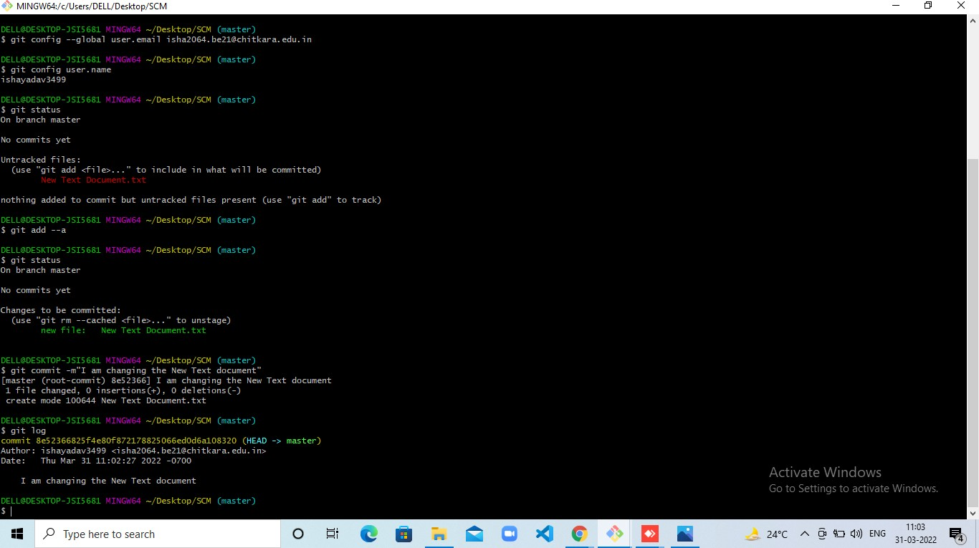
Basic Git log
Git log command is one of the most usual commands of git. It is the most useful command
for Git. Every time you need to check the history, you have to use the git log command. The basic git log command will display the most recent commits and the status of the head. It will use as:

Slide 13
Experiment No. 04
Aim: Create and visualize branches in Git
How to create branches?
The main branch in git is called master branch. But we can make branches out of this main master branch. All the files present in master can be shown in branch but the files which are created in branch are not shown in master branch. We also can merge both the parent(master) and child (other branches).
For creating a new branch: git branch “name of branch”
To check how many branches we have : git branch
To change the present working branch: git checkout “name of the branch”
Visualizing Branches:
To visualize, we have to create a new file in the new branch “activity1” instead of the master branch. After this we have to do three step architecture i.e. working directory, staging area and git repository.
After this I have done the 3 Step architecture which is tracking the file, send it to stagging area and finally we can rollback to any previously saved version of this file.
After this we will change the branch from activity1 to master, but when we switch back to
master branch the file we created i.e “hello” will not be there. Hence the new file will not be shown in the master branch. In this way we can create and change different branches. We can also merge the branches by using the git merge command.
In this way we can create and change different branches. We can also merge the branches by using git merge command.

Slide 14
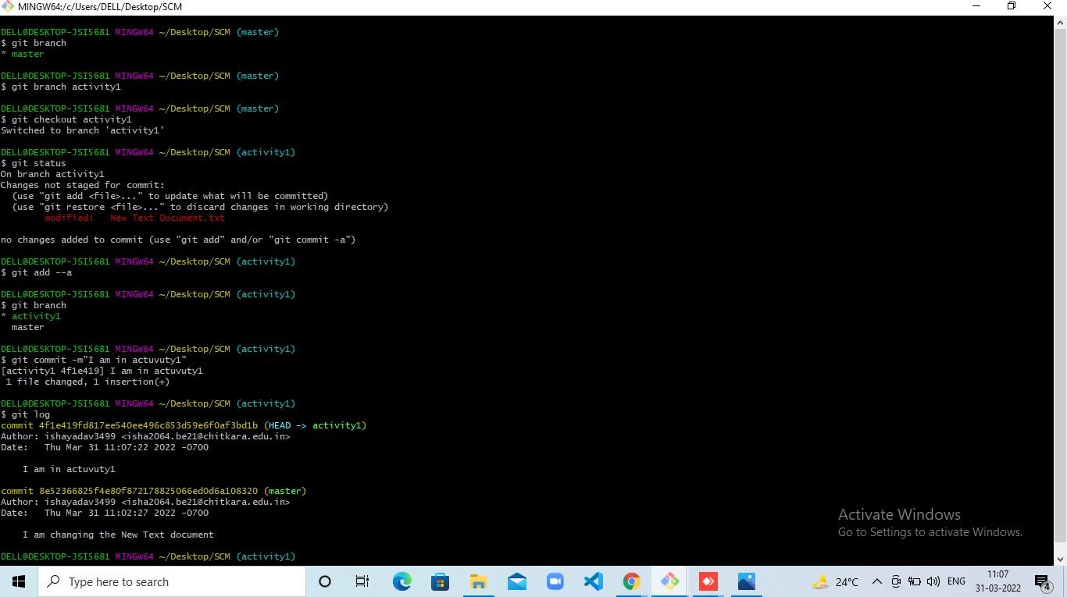

Slide 15
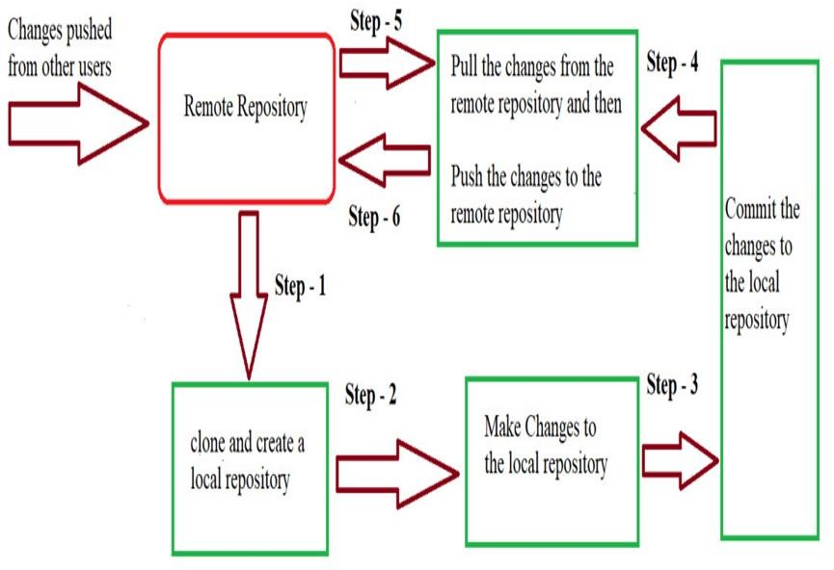
Experiment No. 05
Aim: Git lifecycle description
Git is used in our day-to-day work, we use Git for keeping a track of our files, working in a collaboration with our team, to go back to our previous code versions if we face some error. Git helps us in many ways. Let us look at the Lifecycle description that git has and understand more about its life cycle. Let us see some of the basic steps that we have to follow while working with Git-
Step 1- We first clone any of the code residing in the remote repository to make our won local repository.
Step 2- We edit the files that we have cloned in our local repository and make the necessary changes in it.
Step 3- We commit our changes by first adding them to our staging area and committing them with a commit message.
Step 4 and Step 5- We first check whether there are any of the changes done in the remote repository by some other users and we first pull that changes.
Step 6- If there are no changes we push our changes to the remote repository and we are done with our work.

Slide 16
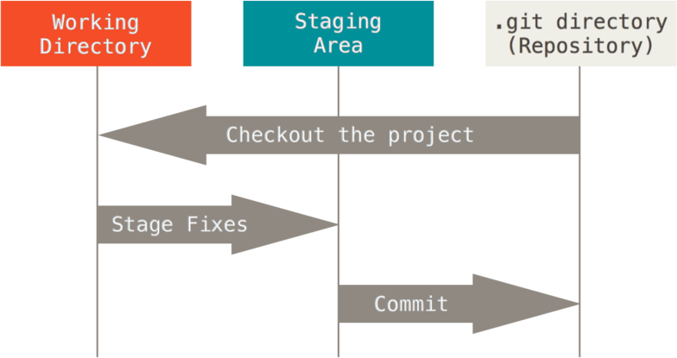
When a directory is made a git repository, there are mainly 3 states which make the essence of Git version Control System. The three states are-
This Photo by Unknown Author is licensed under CC BY-SA
Working Directory
Whenever we want to initialize aur local project directory to make a Git repository, we use the git init command. After this command, git becomes aware of the files in the project although it does not track the files yet. The files are further tracked in the staging area.
Staging Area
Now, to track files the different versions of our files we use the command git add. We can term a staging area as a place where different versions of our files are stored. git add command copies the version of your file from your working directory to the staging area. We can, however, choose which files we need to add to the staging area because in our working directory there are some files that we don’t want to get tracked, examples include node modules, temporary files, etc. Indexing in Git is the one that helps Git in understanding which files need to be added or sent. You can find your staging area in the .git folder inside the index file.
git add<filename>
git add.
Git Directory

Slide 17
Now since we have all the files that are to be tracked and are ready in the staging area, we are ready to commit aur files using the git commit command. Commit helps us in keeping the track of the metadata of the files in our staging area. We specify every commit with a message which tells what the commit is about. Git preserves the information or the metadata of the files that were committed in a Git Directory which helps Git in tracking files basically it preserves the photocopy of the committed files. Commit also stores the name of the author who did the commit, files that are committed, and the date at which they are committed along with the commit message. git commit -m <Message>

Slide 18
TASK 1.2

Slide 19
Experiment No. 06
Aim: Add collaborators on GitHub Repo
In GitHub, We can invite other GitHub users to become collaborators to our private repositories(which expires after 7 days if not accepted, restoring any unclaimed licenses). Being a collaborator, of a personal repository you can pull (read) the contents of the repository and push (write) changes to the repository. You can add unlimited collaborators on public and private repositories(with some per day limit restrictions). But, in a private repository, the owner of the repo can only grant write-access to the collaborators, and they can't have the read-only access.
GitHub also restricts the number of collaborators we can invite within a period of 24 hours. If we exceed the limit, then either we have to wait for 24-hours or we can also create an organization to collaborate with more people
Actions that can be Performed By Collaborators
Collaborators can perform a number of actions into someone else's personal repositories, they have gained access to Some of them are, • Create, merge, and close pull requests in the repository • Publish, view, install the packages • Fork the repositories • Make the changes on the repositories as suggested by the Pull requests. • Mark issues or pull requests as duplicate • Create, edit, and delete any comments on commits, pull requests, and issues in the repository • Removing themselves as collaborators on the repositories. • Manage releases in the repositories.

Slide 20
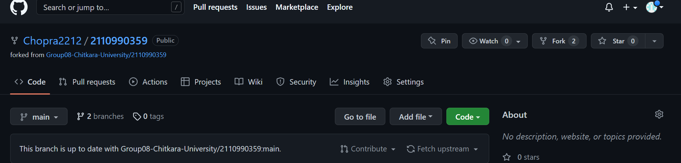
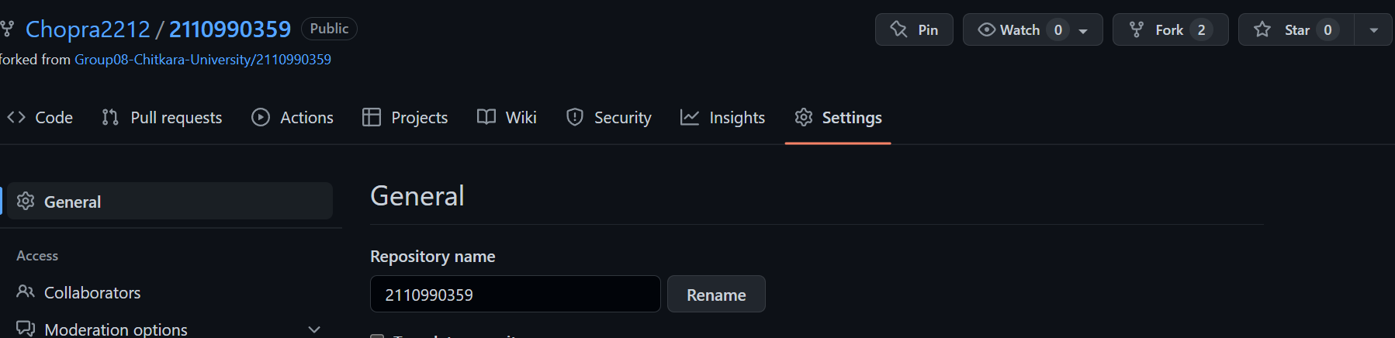
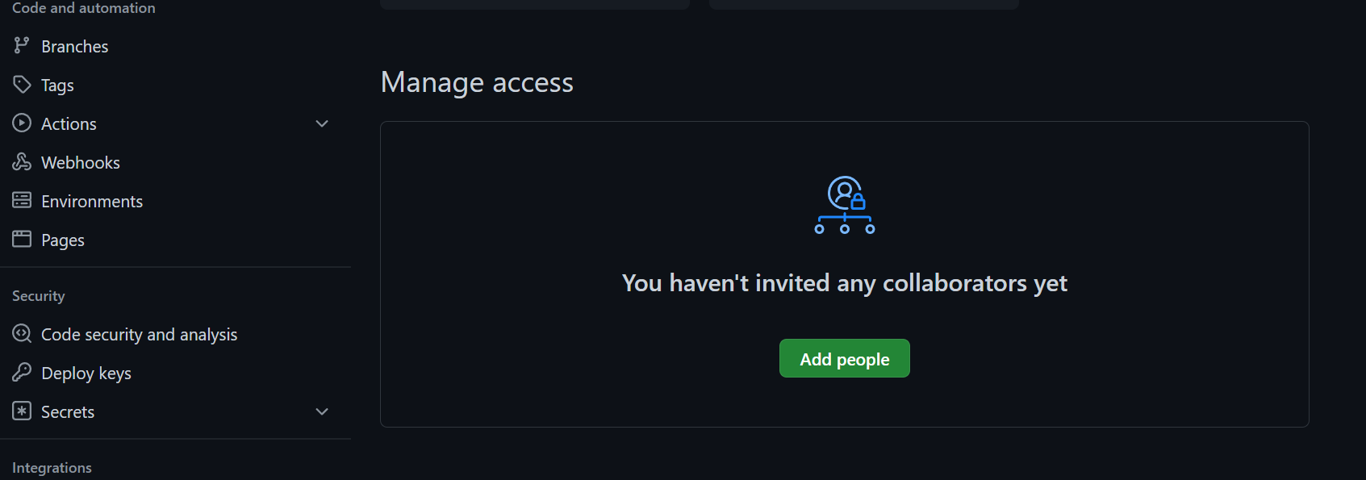
Step 1 − Click on the Setting s tab in the right corner of the GitHub page.
Step 2 : A settings page will appear. Here, into the left-sidebar click into the Collaborators.
Step 3: Then a confirm password page may appear, enter your password for the confirmation.
Step 4: Next, click into Add People.

Slide 21
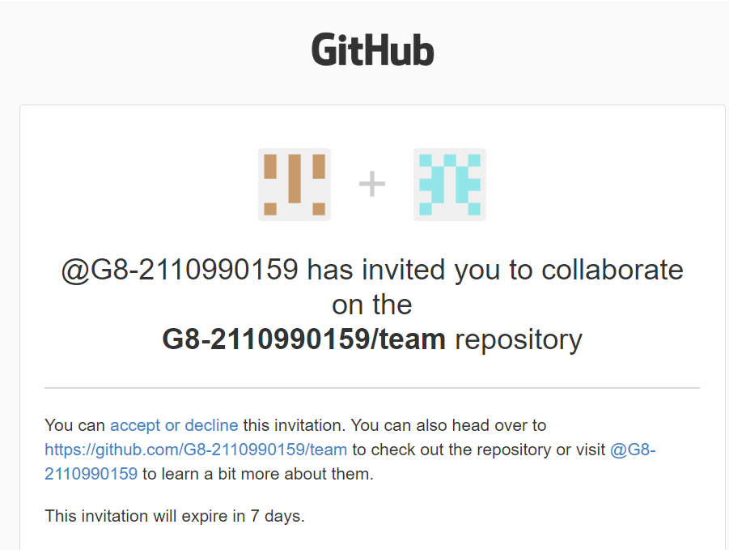
Step 5: After sending the request for collaboration to that person whom we wanted as our collaborator for our project will get a email from the Team leader (by GitHub). He/she has to open its Email to view the invitation.
Step 6: After Clicking the View invitation, He/she will be redirected to the GitHub Page for accepting the invitation sent by the team leader.

Slide 22
Experiment No. 07
Aim: Fork and Commit
A fork is a rough copy of a repository. Forking a repository allows you to freely test and debug with changes without affecting the original project. One of the excessive use of forking is to propose changes for bug fixing. To resolve an issue for a bug that you found, you can:
o Fork the repository.
o Make the fix.
o Forward a pull request to the project owner.
The forking and branching are excellent ways to contribute to an open-source project. These two features of Git allows the enhanced collaboration on the projects. Forking is a safe way to contribute. It allows us to make a rough copy of the project. We can freely experiment on the project. After the final version of the project, we can create a pull request for merging.
Step 1: Go to Project SCM official repository.
Step 2: Find the Fork button on the top right corner.

Slide 23
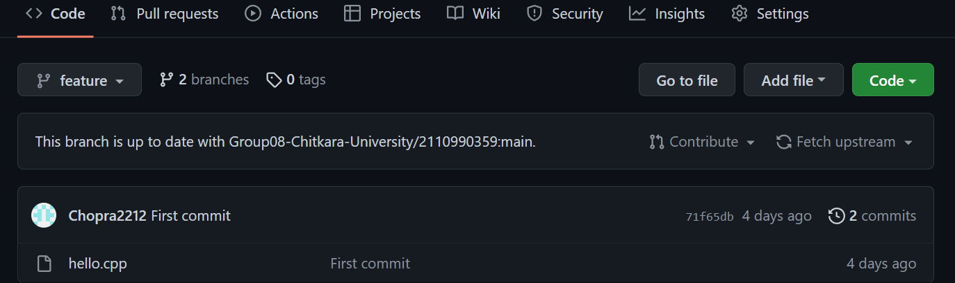
Step 3: Click on Fork.
What is COMMIT in GitHub?
Commit is like a snapshot of your repository. These commits are snapshots of your entire repository at specific times. You should make new commits often, based around logical units of change. Over time, commits should tell a story of the history of your repository and how it came to be the way that it currently is. Commits include lots of metadata in addition to the contents and message, like the author, timestamp and more.
It is similar to saving a file that’s been edited, a commit records changes to one or more files in your branch. Git assigns each commit a unique ID, called a SHA or hash, that identifies:
• The Specific Changes
• When the Changes were made
• Who created the changes
When you make a commit, you must include a commit message that briefly describes the changes, you can also add a co-author on any commits you collaborate on. Now, we will see the main repository content of the main Project-SCM Repository.

Slide 24
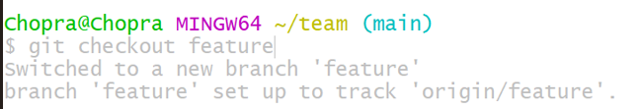
Experiment No. 08
Aim: Merge and Resolve conflicts created due to own activity and collaborators activity.
git checkout master
Before you run this command, make sure that you have pushed the latest code in your current branch (feature_merge in this example) otherwise Git won’t let you checkout the master branch.
git pull
This command will make sure that you have the latest version of the repository in your computer, so all the new code in master and reference to any new branches that might have been created recently.
git checkout feature_merge
we can get back to the branch that we want to merge into master by running the command above.

Slide 25
git add
After saving the file we have just fixed, it’s time to glide over to a wonderful merge. So now we run git add . to let git know which files we want to commit next.
git merge master
This command tells git to merge whichever branch we are currently in(feature_merge) with master. As we can see, git tried to auto-merge but it wasn’t able to do so which made it alert us of a merge conflict, which means that now we get to use the secret tool… , Visual Studio Code’s conflict resolution tool. If you have been using VSCode for this, you can probably see something like the picture below being displayed.

Slide 26
Experiment No. 08
Aim: Reset and Revert
Git Reset
The git reset command allows you to RESET your current head to a specified state. You can reset the state of specific files as well as an entire branch. This is useful if you haven't pushed your commit up to GitHub or another remote repository yet.
Git Revert
Both the git revert and git reset commands undo previous commits. But if you've already pushed your commit to a remote repository, it is recommended that you do not use git reset since it rewrites the history of commits. This can make working on a repository with other developers and maintaining a consistent history of commits very difficult. Instead, it is better to use git revert, which undoes the changes made by a previous commit by creating an entirely new commit, all without altering the history of commits.

Slide 27
Team task

Slide 28
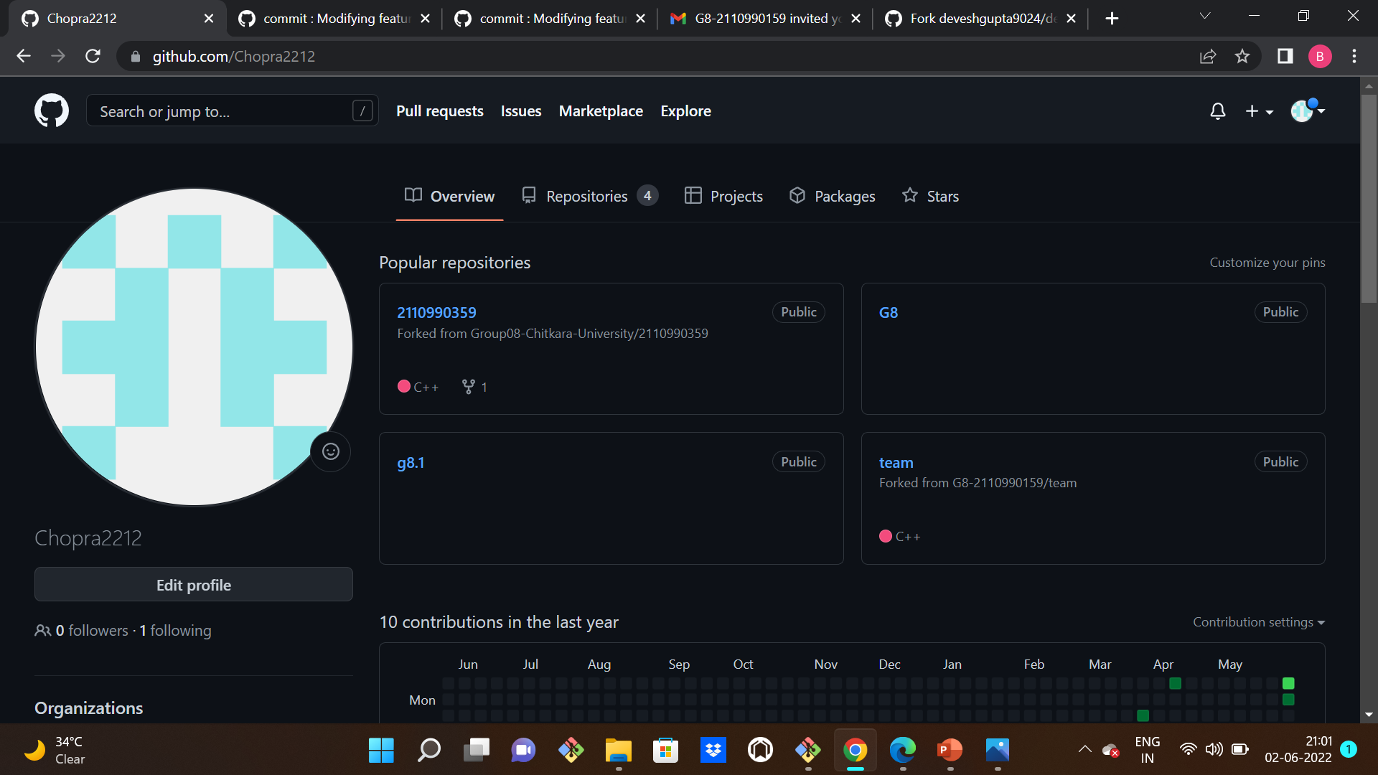
Experiment No. 09
Aim: Practical demonstration of creating repositories and contributing by members.
Create Distributed Repository and add members • Open GitHub home page, in the right corner you can find your profile logo beside it is + icon which is used to create repositories. Create repository from there.
Forking is done by using the “Fork” button that is visible on opening the repository. After clicking on it, I successfully get a copy of this repository on my own git hub account. And this is now ready for us to clone and make our changes that we want to commit also

Slide 29
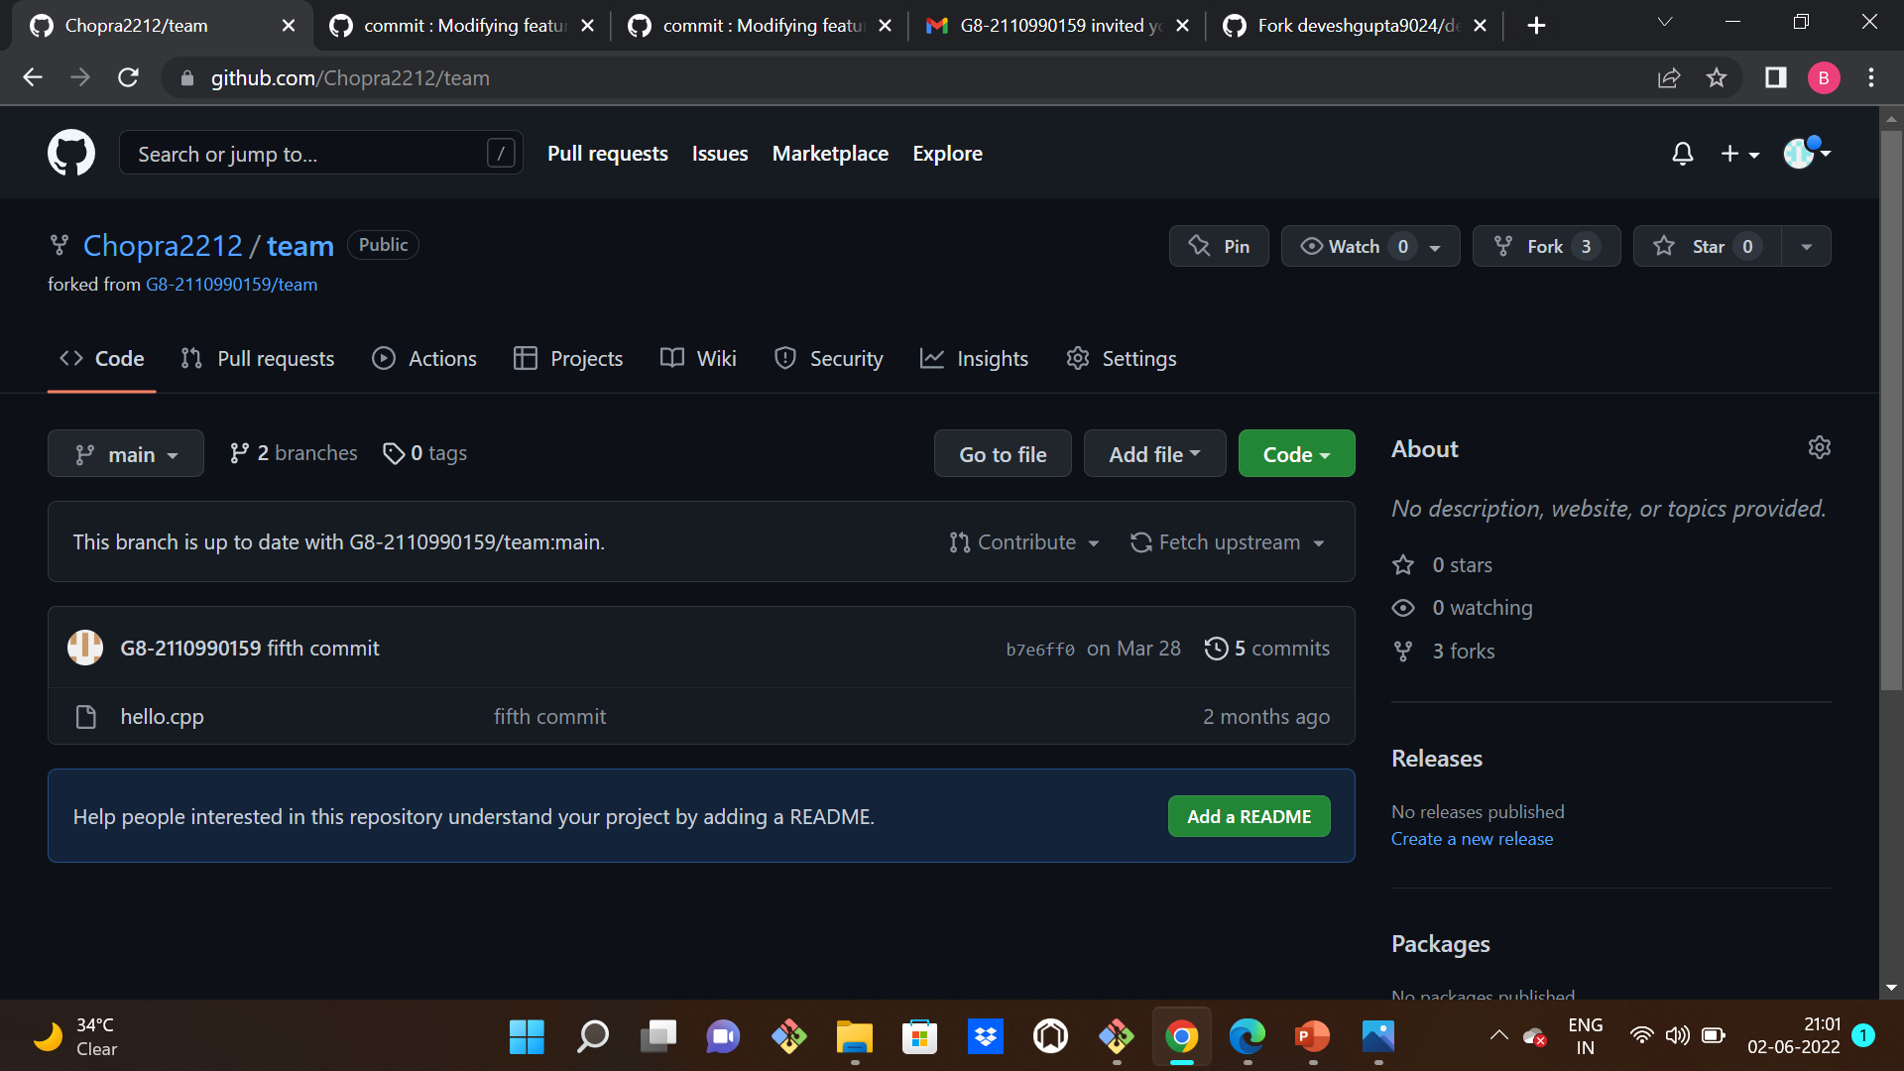
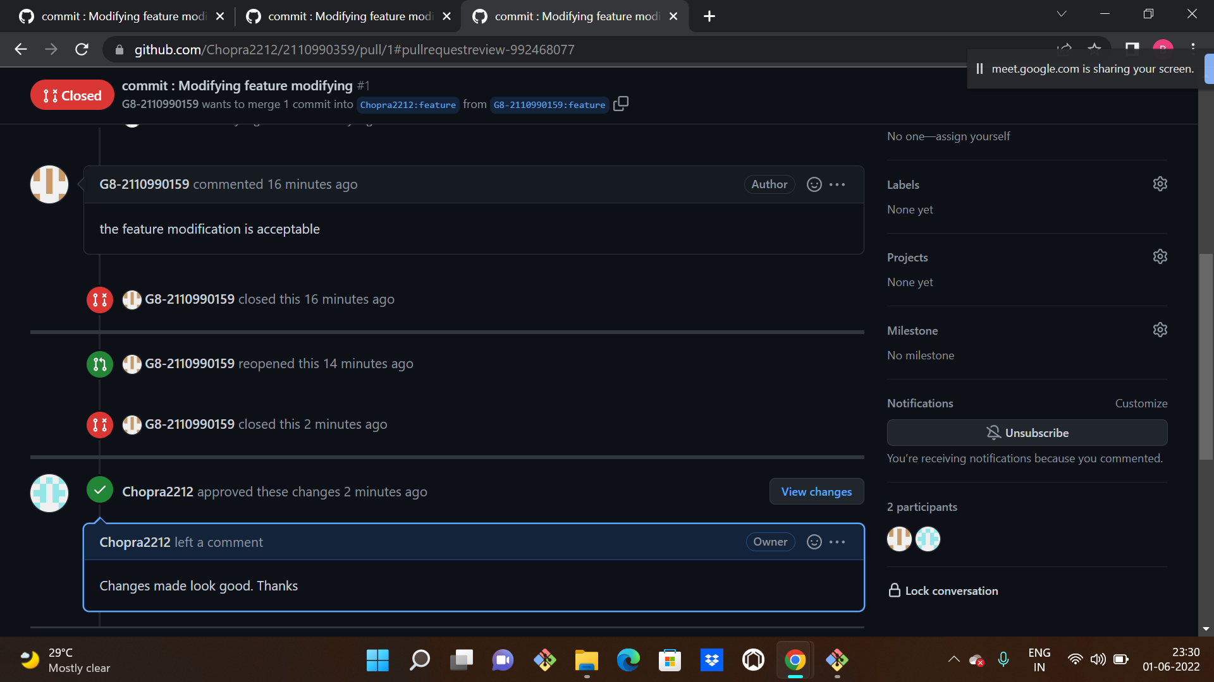
This is the list of the commits made by the team member:

Slide 30
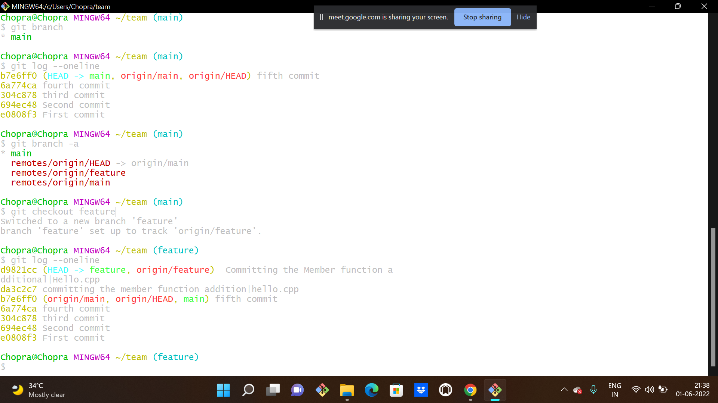
A new branch is created named feature in which I will make my desired changes. As the changes are committed. This file is going to be added to the staging area and then pushed to my own git hub account from where I can generate a pull request to team member 1 to merge into his account.
Now after pushing the repo on my git hub account, we can see clearly that the Compare & pull request button takes a good shape! On clicking this button, a pull request is generated that has to be merged by the team member on whose repo I have committed changes.

